Slide 1
Business Process Engineering
Week # 3
Fall-2025

Slide 2
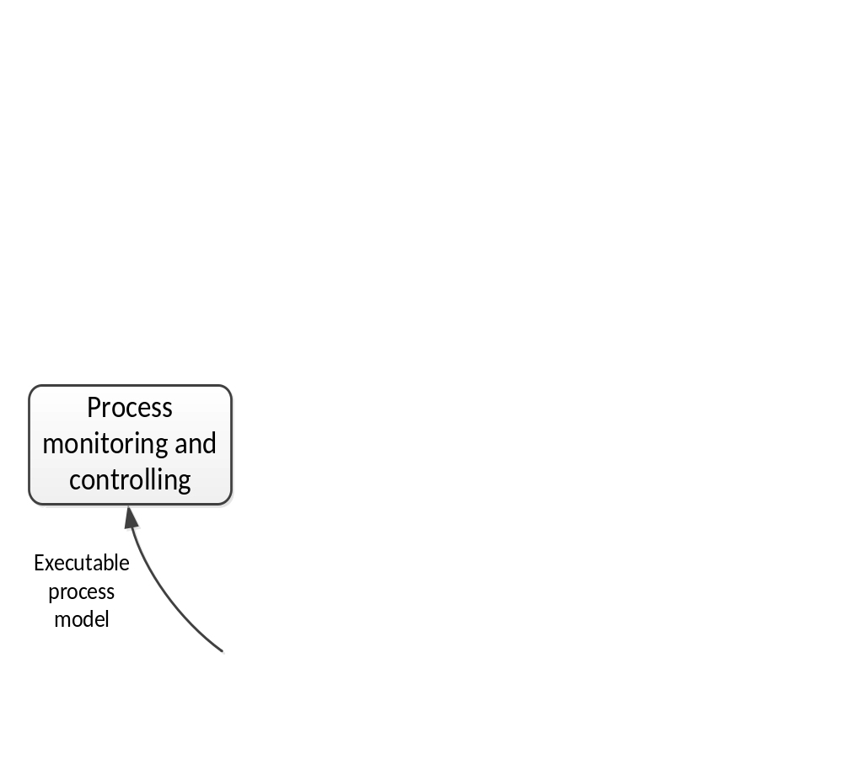
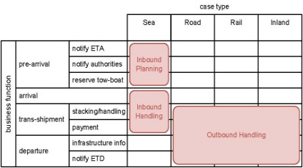
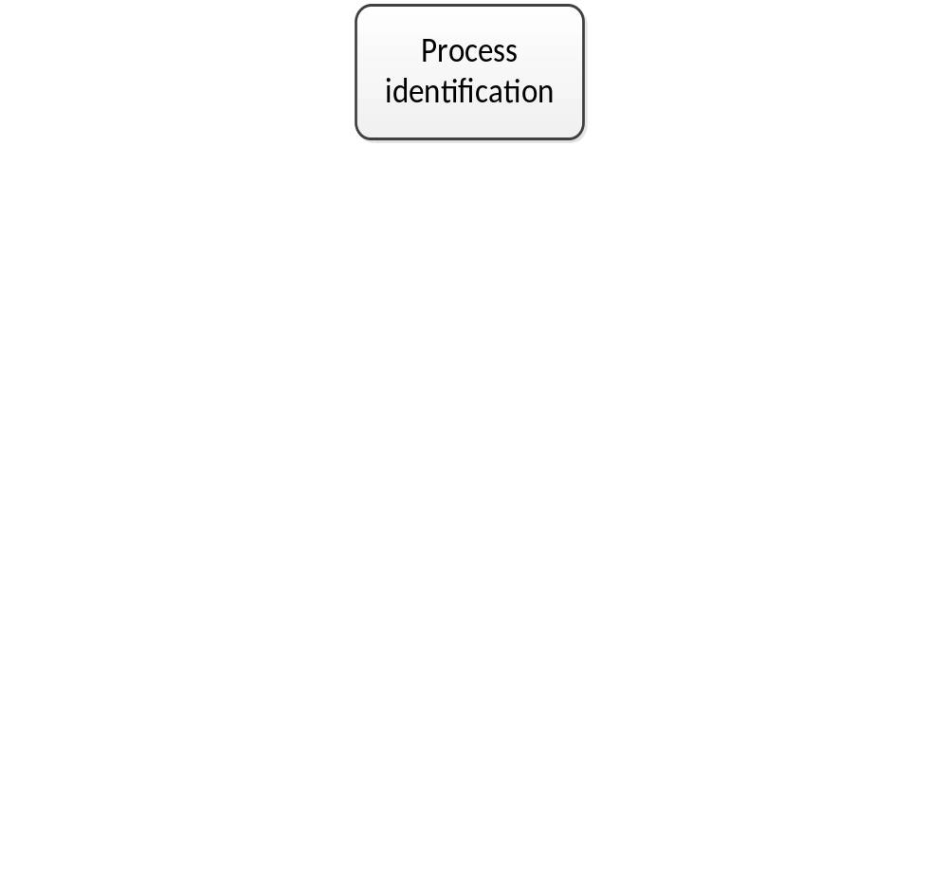
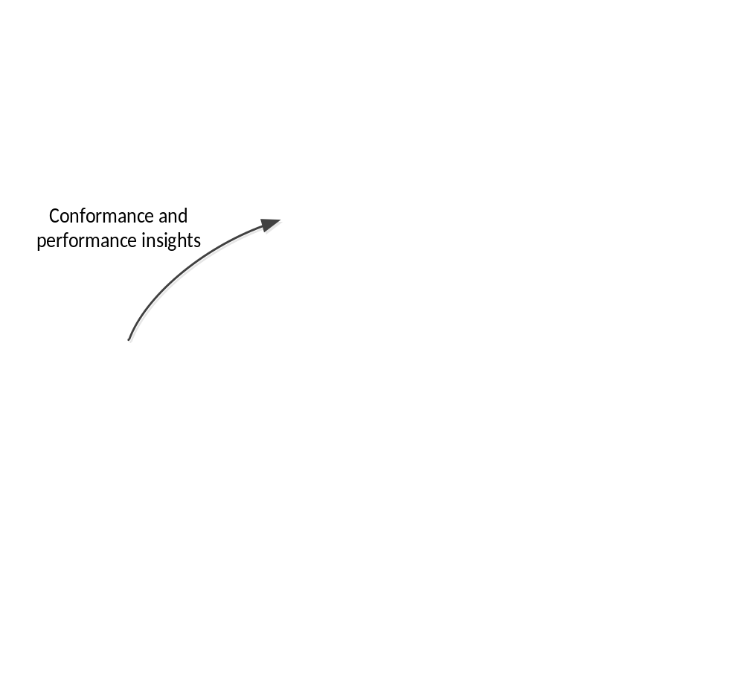
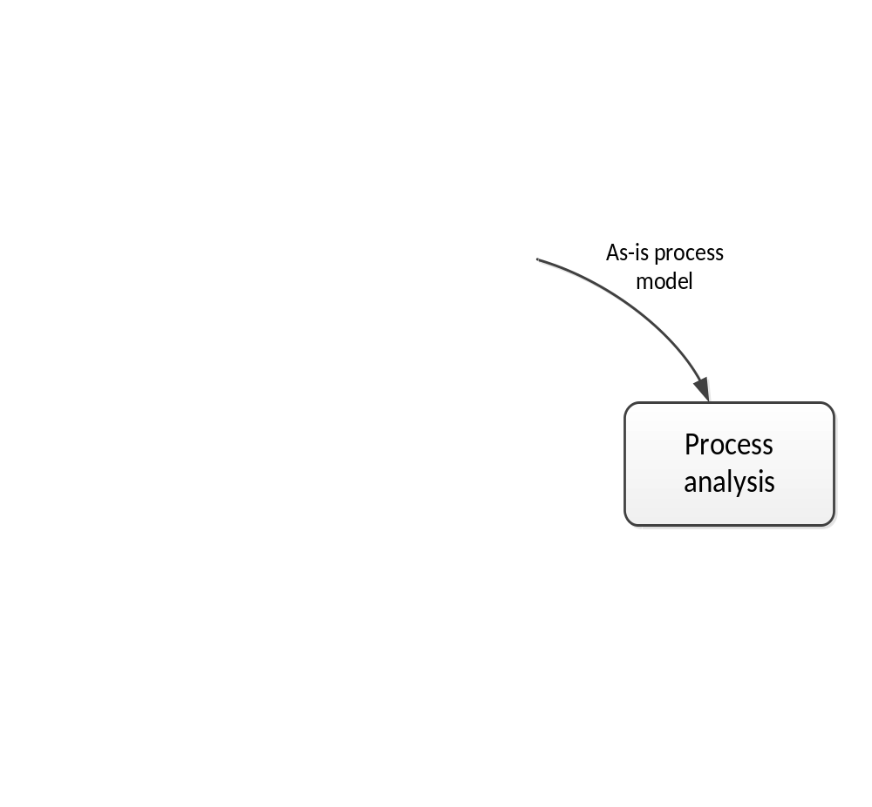
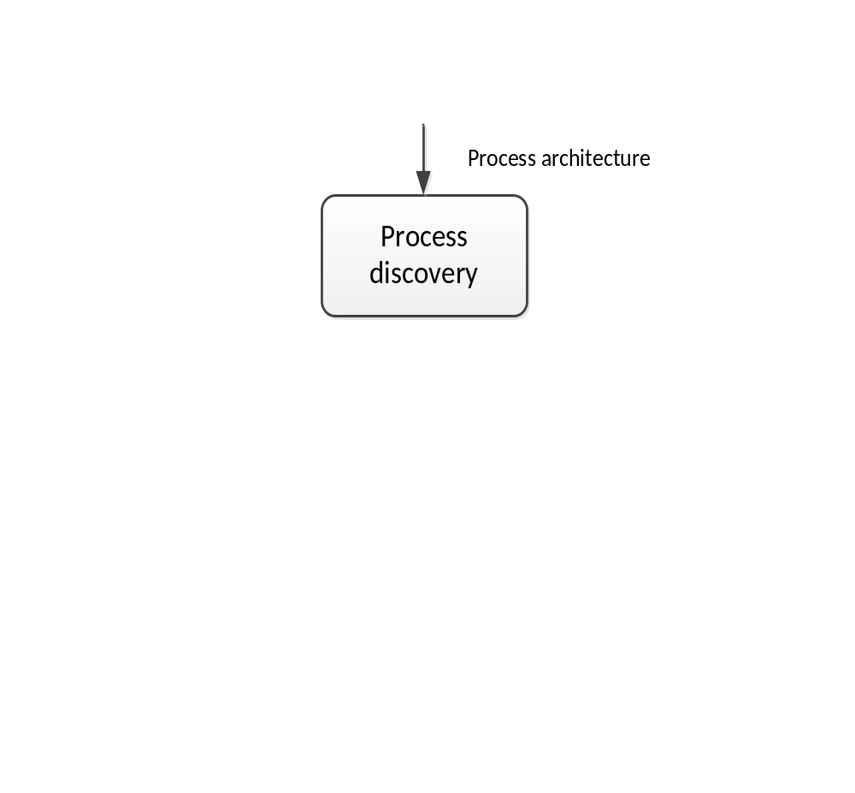
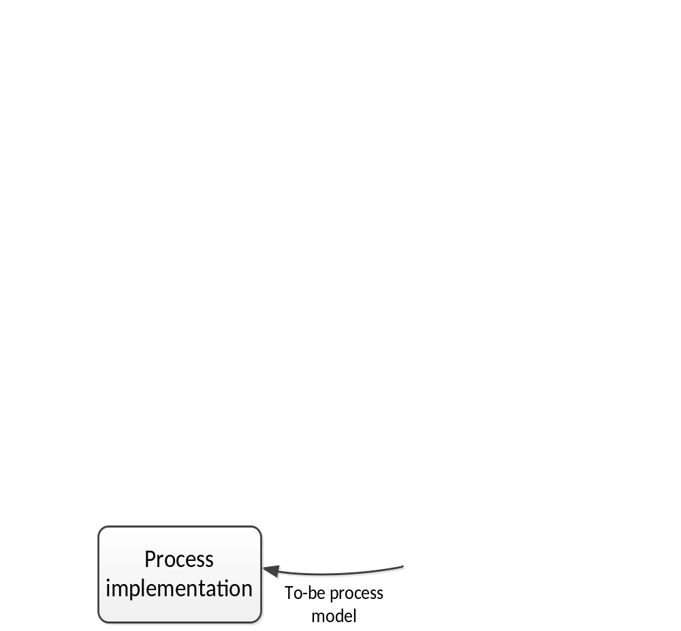
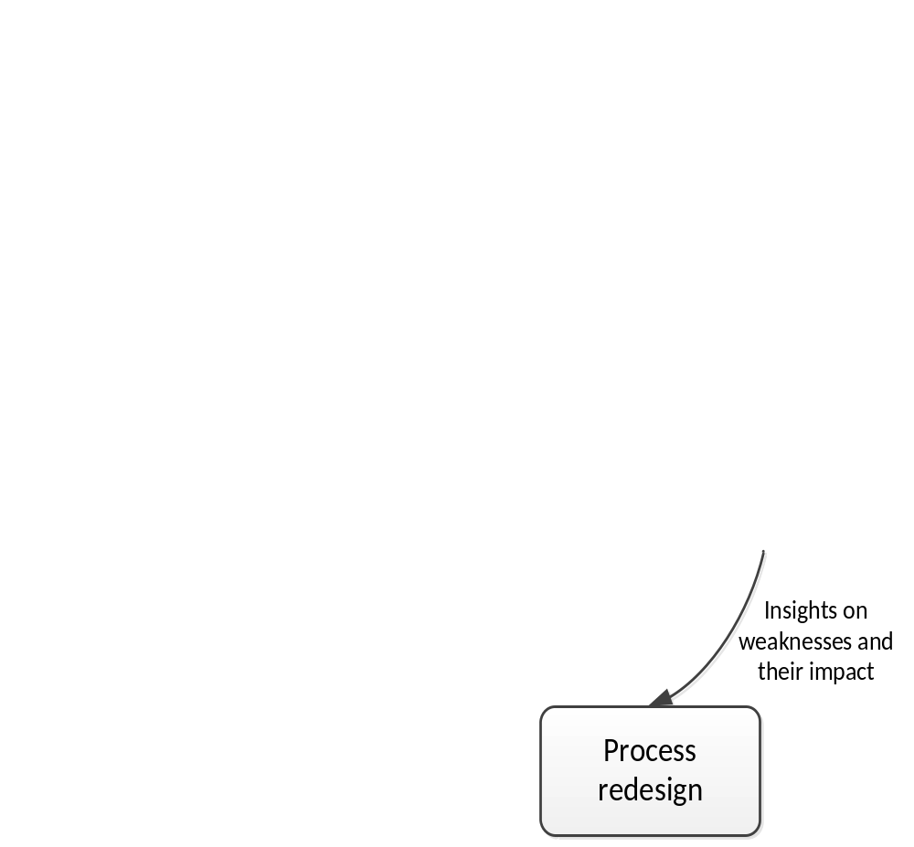
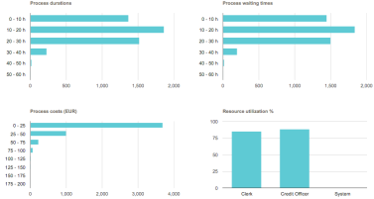

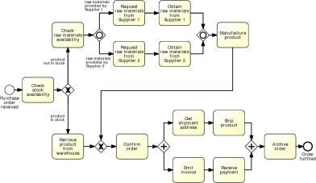
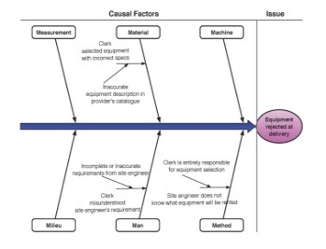
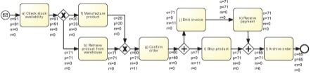
BPM Lifecycle

Slide 3
Process Identification
In this phase:
  A business problem is posed
  Processes relevant to the problem are:
    Identified,
    Delimited, and
    Related to each other
Outcome of process identification is a new or updated process architecture that provides an overall view of the processes in an organization and their relationships

Slide 4
Process Identification
What ?
  Identify an organization’s business processes
  Prioritize their management based on certain criteria
Why ?
  Understand the organization
  Maximize value of BPM projects

Slide 5
Process Identification Steps
Designation Step
  Enumerate main processes
  Determine process scope
Prioritization Step: prioritize processes based on:
  Importance
  Health
  Feasibility
Process Architecture
Prioritized Process Portfolio

Slide 6
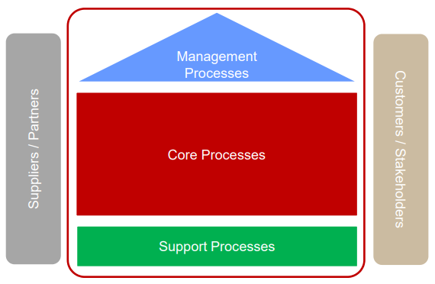

Types of Processes

Slide 7
Wholesaler – Example of Processes
Core Processes
  Sales (lead-to-quote, quote-to-order, order-to-cash)
  Direct Procurement (supplies, replenishment)
Support Processes
  Indirect Procurement (parts replenishment, operational resources replenishment, …)
  HR (recruitment, induction, probation, …)
Management Processes
  Suppliers management (suppliers planning, suppliers acquisition …)
  Logistics management (logistics planning, logistics controlling …)

Slide 8
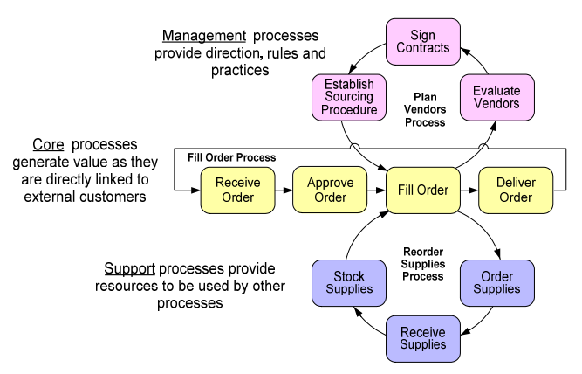
Core, Support and Management Processes

Slide 9
Exercise: Identify Process Types in a University Environment
Support Services
HR
Indirect Procurement
Strategic Management
Teaching Award Courses
IP Management
Marketing
Course Management
Additional Services Management
Language Training
Admission
IT
Market Management
Teaching Professional Courses

Slide 10
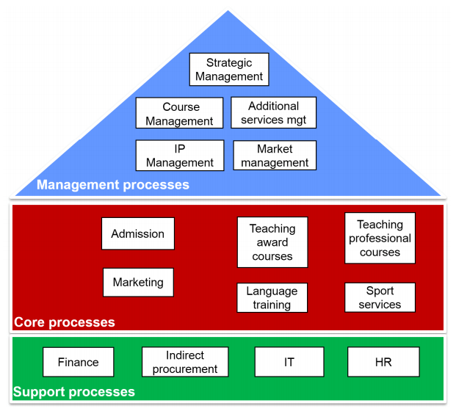
Solution

Slide 11
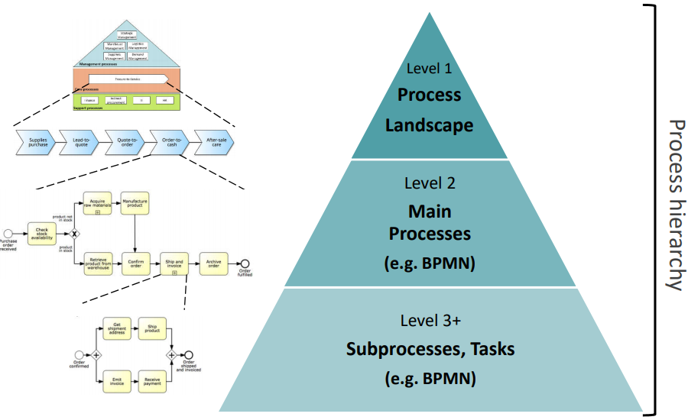
Process Architecture: Hierarchical View

Slide 12
Prioritization aka Process Selection
Importance
  Which processes have greatest impact on the organization’s strategic objectives?
Health (or Dysfunction)
  Which processes are in deepest trouble?
Feasibility
  Which processes are most susceptible to successful process management?

Slide 13
Process discovery
The act of gathering information about an existing process and organizing it in terms of an as-is process model
  Emphasizes gathering and organizing information
  Modeling is a part of this activity

Slide 14
Process Discovery
Defining the setting: assemble a team in a company that will be responsible for working on the process.
Gathering information: build an understanding of the process. Different discovery methods can be used to acquire information on a process.
Conducting the modeling task: organize the creation of the process model. The modeling methodology gives guidance for mapping out the process in a systematic way.
Assuring process model quality: guarantee that the resulting process model meets different quality criteria. This phase is important for establishing trust in the process model.
Notes:
QUT Brisbane, Dr. Jan Recker

Slide 15


Who is involved?
Process Analyst
Domain Expert
Notes:
QUT Brisbane, Dr. Jan Recker

Slide 16
Typical profile of process analyst and domain expert
Aspect | Process Analyst | Domain Expert
Modeling Skills | strong | limited
Process Knowledge | limited | strong

Slide 17
What Makes a Good Process Analyst
Getting the right people on board
Formulate and test hypotheses
Identify patterns
Pay attention to model aesthetics
Notes:
QUT Brisbane, Dr. Jan Recker

Slide 18


Process Discovery Methods
Evidence-based
  Document analysis
  Observation
  Automatic process discovery
Interview-based
Workshop-based
Notes:
QUT Brisbane, Dr. Jan Recker

Slide 19
Organizing the Gathered Material
Identify the process boundaries
Identify activities and events
Identify resources and their handovers
Identify the control flow
Identify additional elements

Slide 20
Process Boundaries
Under which condition does the process start?
With which result does it end?
Which perspective do we assume?

Slide 21
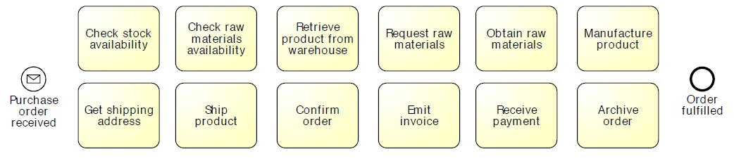
Identify Activities and Events

Slide 22
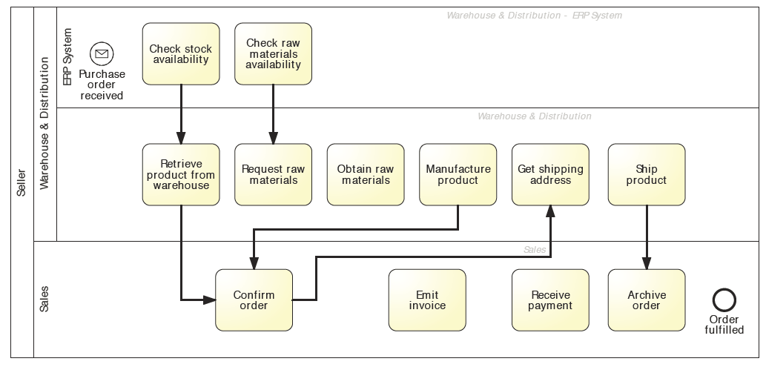
Identify Resources and Handovers

Slide 23
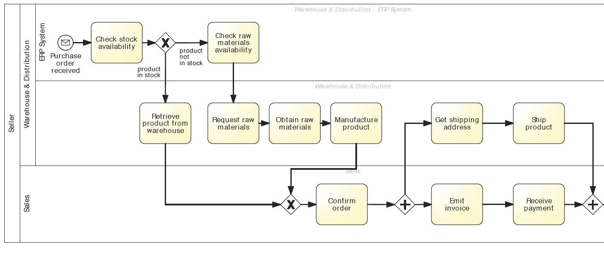
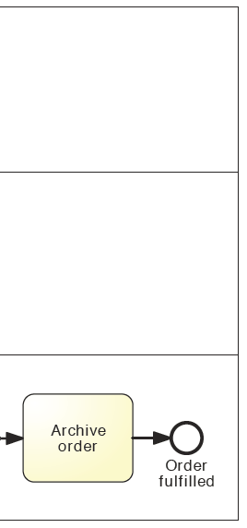
Identify Control Flow

Slide 24
3. Process Analysis
Issues associated to the as-is process are identified, documented and whenever possible quantified using performance measures
Output of this phase is a structured collection of issues
These issues are typically prioritized in terms of their impact, and sometimes also in terms of the estimated effort required to resolve them

Slide 25
Business Process/Workflow Analysis
Types of Analysis
  Quantitative (performance)
  Average completion time
  Level of service
  Qualitative (correctness)
  Deadlock
  Live lock

Slide 26
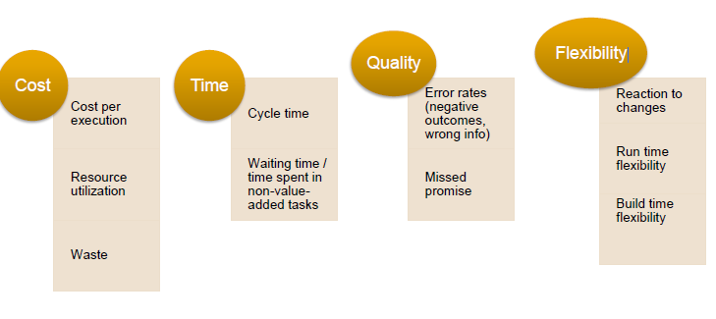
Goodness Criteria: Quantitative Analysis Measures
Notes:
Cycle time - Ddifference between a job’s start and end time
Cycle time analysis: the task of calculating the average cycle time for an entire process or process fragment
Assumes that the average activity times for all involved activities are available
In the simplest case a process consists of a sequence of activities on a sequential path
The average cycle time is the sum of the average activity times
… but in general we must be able to account for
Alternative paths (XOR splits)
Parallel paths (AND splits)
Rework (cycles)

Slide 27
4. Process Redesign
Also called process improvement
Goal of this phase is to identify changes to the process that would help to address the issues identified in the previous phase and allow the organization to meet its performance objectives
Multiple change options are analysed and compared in terms of the chosen performance measures.
This entails that process redesign and process analysis go hand-in-hand: As new change options are proposed, they are analysed using process analysis techniques. Eventually, the most promising change options are combined, leading to a redesigned process.
Output is typically a to-be process model, which serves as a basis for the next phase.

Slide 28
5. Process Implementation
Changes required to move from the as-is process to the to-be process are prepared and performed
Process implementation covers two aspects:
  Organizational Change Management – refers to the set of activities required to change the way of working of all participants involved in the process
  Process Automation – refers to the development and deployment of IT systems (or enhanced versions of existing IT systems) that support the to-be process

Slide 29
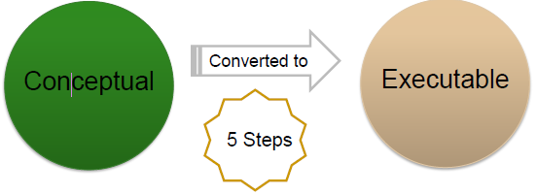
Conceptual to Executable processes Conceptual
Identify the automation boundaries
Review the manual tasks
Complete the process model
Adjust the task granularity
Specify the execution operations
Notes:
Not all the tasks in a process can be automated
So classify boundaries ,manual task, user task, automated task.

Slide 30
Conceptual to Executable processes
Conceptual
Made by domain experts
Provides basis for communication amongst relevant stakeholders
Must be intuitive and may leave room for interpretation
Contains purely a relevant set of process information
Executable
Are made by IT experts
Provide input to a process enactment systems – BPMS.
Must be machine readable
Must be unambiguous and should not contain any uncertainties .
Contain further details that are only relevant to implementation

Slide 31
6. Process Monitoring and Controlling
Once the redesigned process is running, relevant data are collected and analysed to determine how well is the process performing with respect to its performance measures and performance objectives
Bottlenecks, recurrent errors or deviations with respect to the intended behaviour are identified and corrective actions are undertaken
New issues may then arise, in the same or in other processes, requiring the cycle to be repeated on a continuous basis.

Slide 32
BPM Lifecycle Stakeholders
Management Team – responsible for overseeing all processes, initiating process redesign initiatives, and providing resources and strategic guidance to stakeholders involved in all phases of the business process lifecycle
Process Owners – responsible for the efficient and effective operation of a given process. The process owner is involved in process modelling, analysis, redesign, implementation and monitoring.

Slide 33
BPM Lifecycle Stakeholders
Process Participants – Process participants are human actors who perform the activities of a business process on a day-to-day basis. They are also involved as domain experts during process discovery and process analysis. They support redesign activities and implementation efforts
Process Analysts – Conduct process identification, discovery (in particular modelling), analysis and redesign activities. They have one of two backgrounds. Process analysts concerned with organizational requirements, performance and change management have a business background. Meanwhile, process analysts concerned with process automation have an IT background.

Slide 34
BPM Lifecycle Stakeholders
System Engineers – involved in process redesign and implementation. They interact with process analysts to capture system requirements. Often system implementation, testing and deployment are outsourced to external providers, in which case the system engineering team will at least partially consist of contractors

